Slide 1
Lesson 17 – Homework review

Slide 2
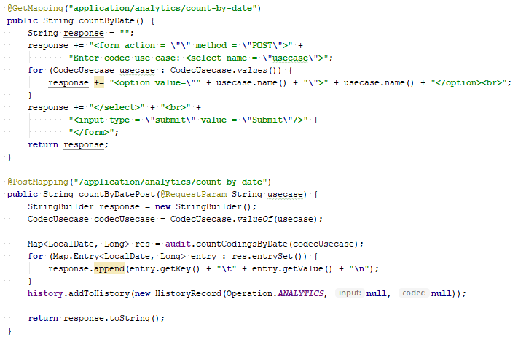
Use Thymeleaf/message converters

Slide 3
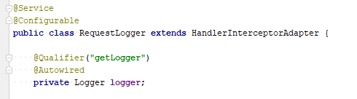
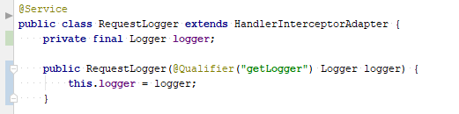
Use injection via constructor

Slide 4
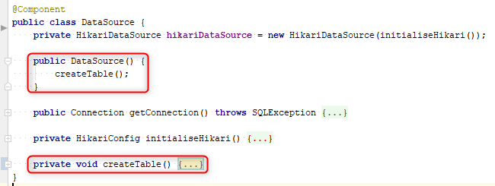
Don’t create table in DataSource constructor

Slide 5
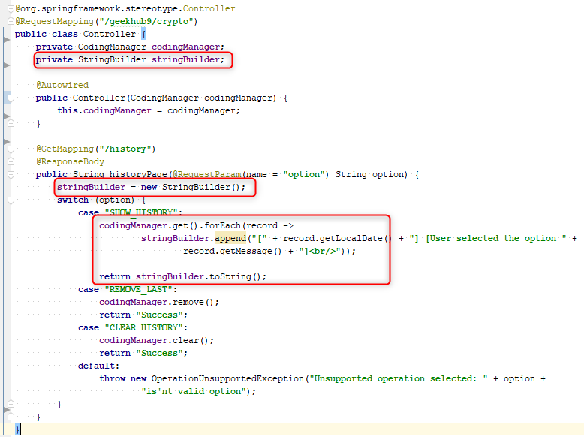
Don’t change state of controller’s fields

Slide 6
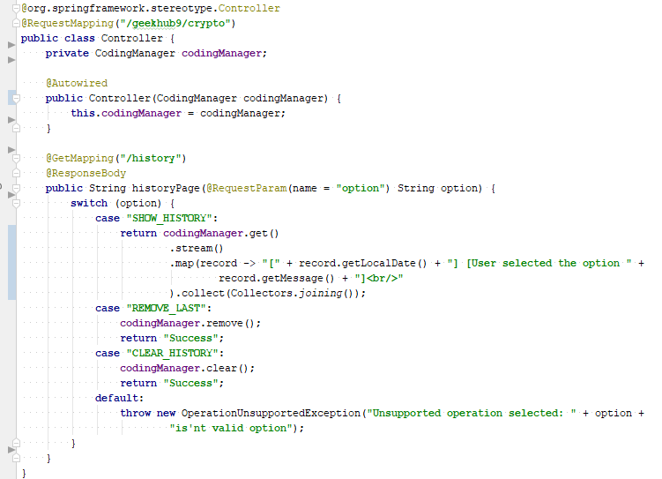
Don’t change state of controller’s fields

Slide 7
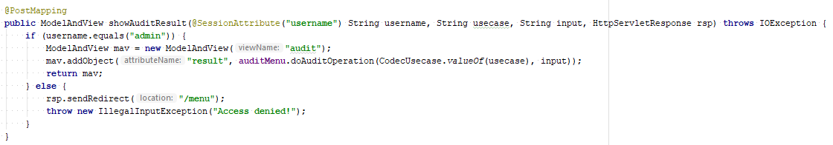
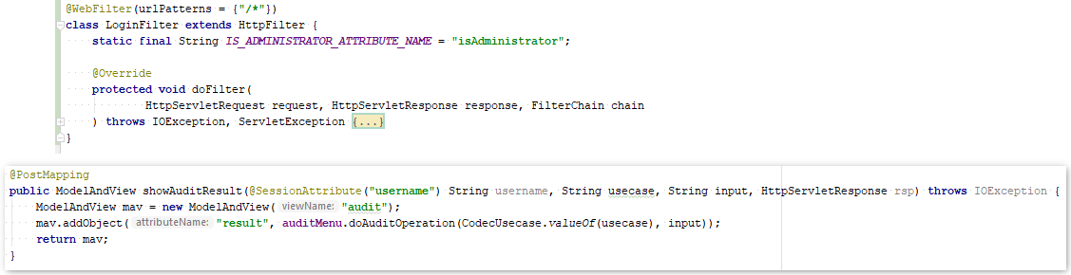
Do not verify access in controller

Slide 8
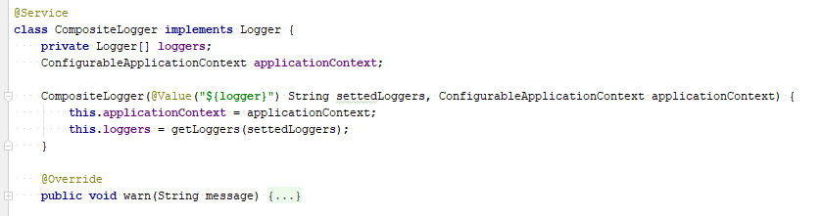
Do not inject ApplicationContext

Slide 9
Apply recommendations from personal feedbacks before starting next homework

